Slide 1
SPRING 2023 COLLECTION
A mood-establishing, descriptive short paragraph
TALKING POINTS: Social Gathering* Poolside*
Color *
Leather *
Knits *
Denim *
Spring Dressing*
Fluid silhouettes that transcend through seasons, the Spring 2023 Collection brings unique styles to the forefront. Luxe fabrications of leathers, knits and coveted denims, each piece is perfect for your next social gathering. Lounging poolside or beating that winter chill, our springtime dressings bring unforgettable tones this season.

Slide 2
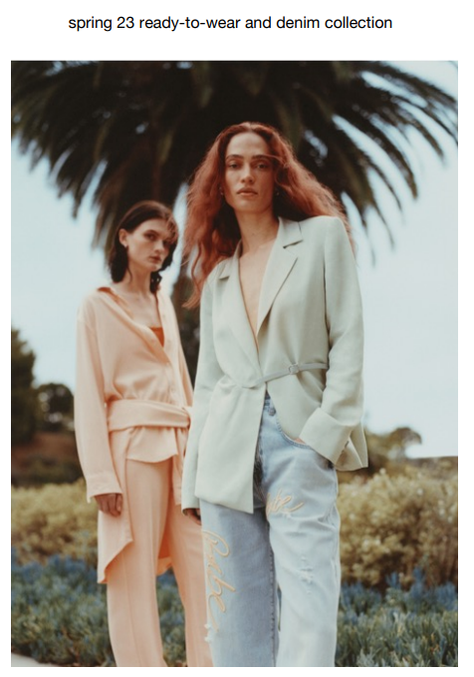
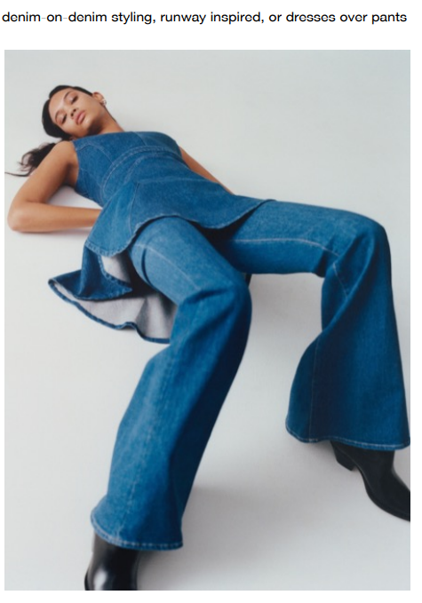
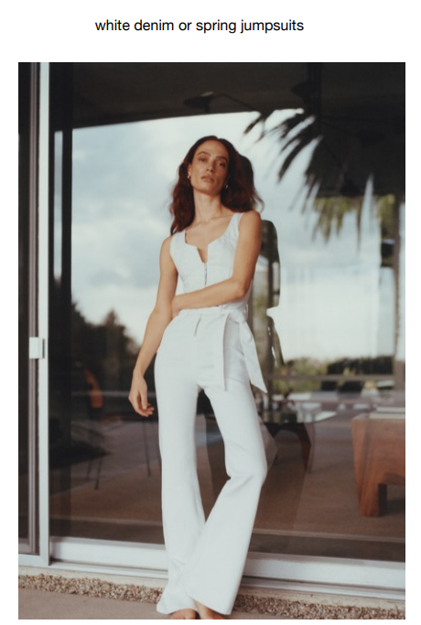
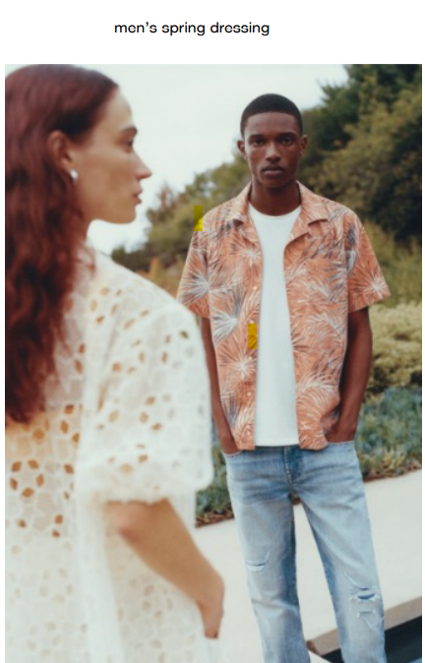
homepage headlines + subs
Spring 23’ Collection Edit
Denim on Denim, YES please
So Fresh & So Chic (In White)
Men’s Spring Selections Redefined
With the new spring 23’ collection ready to emerge with only the latest ready to wear styles and must have denims, deciding which pieces to add to cart is the only thing you will struggle to fit.
A cult classic that will never go out of style, the denim-on denim trend now takes on a modern vibe in vintage washes and cuts.
There’s nothing more enticing then head-to-toe white. A fresh clean look with a laid-back style, this timeless denim paring transcends throughout the seasons from warm summer days to cool winter nights.
Essential color pallets and unforgettable prints, men are stepping up their game when it comes to styles this season.

Slide 3
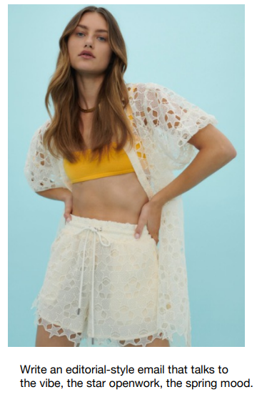
Editorial Emails p1
Airy Spring Vibes
Say Hello to the Compact Knit Capsule
Shed the winter chill and slip into lightweight looks and styles that are sure to get you ready for the new spring season.
Airy knit designs that encompass a star openwork silhouette can be paired with a bold tone top for an added pop of color is a sure way to become a seasonal staple selection.
Ready to embark on your next weekend getaway? First things first, what are you going to wear on your travels.
Our Compact Knit Capsule offers lightweight knits that encapsulate bold leisurewear designs, and merges styles into everyday essentials.
From pants to dresses to even cropped bomber jackets, this collection allows you to piece together an unforgettable ensemble. Mix-and-match these pieces with a pair of denim jeans or go bold with a head-to-toe monochromatic look.

Slide 4
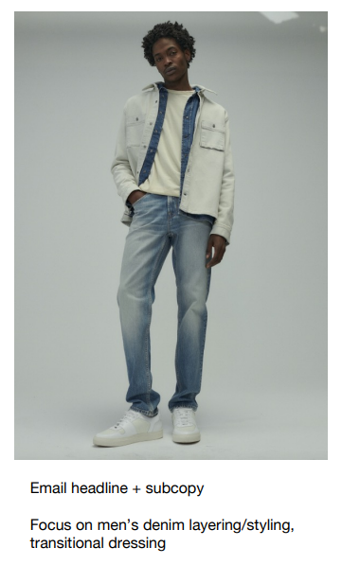
Editorial Emails p2
Spring Tones & Denim Vibes
A muted interlacing of soft cool tones against a light wash denim, make the perfect pairing this spring season.
A straight leg denim design with intentionally distressed areas, intricately stitched artisanal floral and script designs crafts an unforgettable statement piece you won't want to be without.
Wardrobe Refresh
Denim on denim wear is one style that withstands the ever-changing fashion trends.
This simple yet elevated pairing of classic double denim is now an essential closet layering staple.
No matter the season, this is one look that transcends beyond what’s ‘cool’ and always instantly refreshes any look to a clean fresh aesthetic.

Slide 5
short one-line digital ads
Iconic denim styles with a fresh new attitude
Modern fits, luxe fabrics, signature stitched logo design
Laid back styles that don’t compromise fashion
A lived-in feel on perfectly broken in fabric

Slide 6
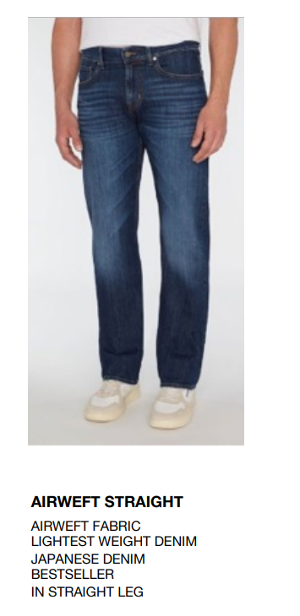
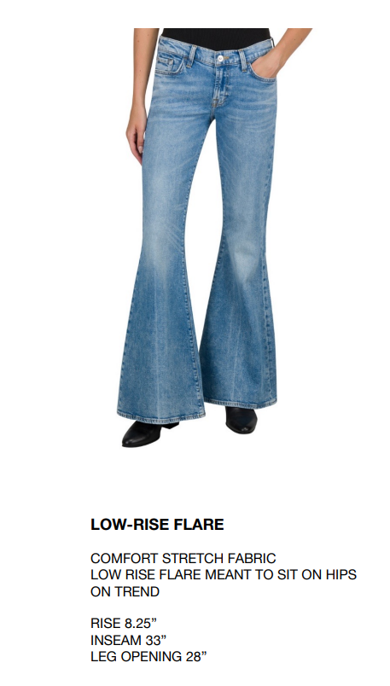
product descriptions approximately 50 words
Crafted from a lustre chambray fabric made of sustainable properties, this belted shirt dress transcends effortlessly between the seasons. From the concealed front button closure to the detachable waist belt to help accentuate your waist, this little number is the perfect selection for your next daytime outing.
A classic denim style with a comfortable stretch fit feel, these low-rise flair bottoms offer the perfect laid-back design. With the low-rise waistband that rests right on the hips to the wide leg flair hem, this immaculate silhouette embodies the perfect effortlessly chic style.
Made from lightweight Japanese denim, the Airweft straight leg offers the perfect refined modern look. From the structured denim fabric to the classic design that never goes out of style, it’s no wonder this pair is a best seller.

