Slide 1
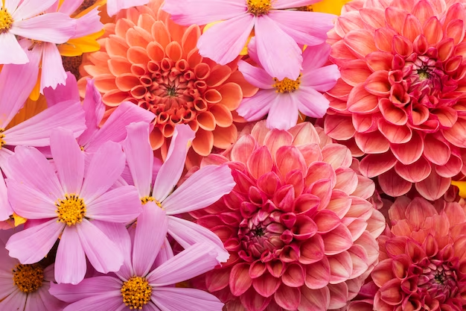
Show Me Your MuMu
Copywriting test/presentation
By Natanya Toomes

Slide 2
Prompt 1
Based on the two products, first write a product description for each, and then list 7-10 search terms you would use to tag each product for visibility when customers search on our website

Slide 3
Nina Skort Dress ~ Garden Party Purple
Search Terms
Floral dress
Floral mini dress
Brunch dress
Wedding guest
Summer floral dress
Summer wedding
Outdoor wedding
Daytime wedding
Vacation dress
Beach wedding
Garden wedding
Happiness blooms from within…..your closet! The Nina Skort Dress in Garden Party Purple is ready be unveiled. With bursts of vibrant colors and tropical floral prints, this design was made to let your style blossom. The Nina Skort Dress serves to add a playful twist to a classic silhouette that ensures you can twirl, dance, and frolic with ease—because life's too short for wardrobe malfunctions.

Slide 4
Sweetheart Sweater ~ Pink Heart Knit
Search Terms
Graphic sweater
Coquette sweater
Cute sweater
Coquette
Knit sweater
Lightweight sweater
Casual sweater
Soft knits
Knit Loungewear
How sweet it is to be worn by you! Crafted with love and infused with cozy charm, the Sweetheart Sweater lets you embrace your inner dainty coquette beauty. Woven with a ribbed knit fabric, and soft blush pink heart center design lets everyone know it’s okay to wear your heart on your sleeve (or chest) because love should always be on full display!

Slide 5
Using the following prompt, please write a minimum 500 word blog post. Prompt: What to Wear to Bridal Shower. Relevant terms These terms are topically relevant to the main topic and can help guide the copy creation. Not all need to be included!
wedding season
winter
jumpsuit
white dress
backyard bridal shower
wedding dress
bride
bridal shower guest outfit
formal bridal shower
winter wedding
engagement party
bridal party
style
shoes
what to wear to a bridal shower
bridal shower
bridal showers
bridal shower outfit
dress
winter bridal shower
bridal shower guest
dress code
perfect outfit
cocktail dress
wedding event
pants

Slide 6
What to Wear to a Bridal Shower
Link to Google Doc of prompt:
https://docs.google.com/document/d/1y6EhjnEUBo3L8MCQkjOCEZYmoPXRqBNWB04IZNN6TNg/edit?usp=sharing

Slide 7
Based on the email creatives below, please provide a subject line and pre-header
Subject Line:
New Fear BLOCKED: Get Ready to Mix + Match Your Way to Summer Style! 🌴☀️"
Preheader: Fear of being unplanned twinsies won't be an issue with Show Me Your Mumu's Mix + Match Swimwear Collection! Explore vibrant colors, abstract prints, & interchangeable bikini tops and bottoms for endless beach-ready looks as unique as you!

Slide 8
This is an upcoming launch. Please write a push notification for our app subscribers.
Short SMS: "Spring dreams come true with Show Me Your Mumu's Abstract Poppy Collection! 🌸"
Long SMS: "Dive into the enchanting world of Show Me Your Mumu's Abstract Poppy Collection! Vibrant greens, playful florals, and vacation-ready vibes make it the perfect ensemble for your springtime girly adventures. Pack your bags – it's time to bloom! 🌷🌿"

